Slide 1
IT2070 – Data Structures and Algorithms
Lecture 06
Introduction to Algorithms
U. U. Samantha Rajapaksha
M.Sc.in IT, B.Sc.(Engineering) University of Moratuwa
Senior Lecturer SLIIT
Samantha.r@slit.lk

Slide 2
ALGORITHMS
Algorithm is any well defined computational procedure that takes some value or set of values as input and produce some value or set of values as output.
3,1,7,2,9,8,5,4,6
1,2,3,4,5,6,7,8,9
ALGORITHM
INPUT
OUTPUT

Slide 3
ALGORITHM (Contd.)
1.Get the smallest value from the input.
2.Remove it and output.
3.Repeat above 1,2 for remaining input until there is no item in the input.

Slide 4
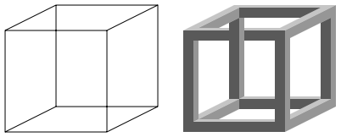
Properties of an Algorithm.
Be correct.
Be unambiguous.
Give the correct solution for all cases.
Be simple.
It must terminate.
Necker_cube_and_impossible_cube
Source:http://en.wikipedia.org/wiki/Ambiguity#Mathematical_interpretation_of_ambiguity

Slide 5
Applications of Algorithms
Data retrieval
Network routing
Sorting
Searching
Shortest paths in a graph

Slide 6
Pseudocode
Method of writing down a algorithm.
Easy to read and understand.
Just like other programming language.
More expressive method.
Does not concern with the technique of software engineering.

Slide 7
Pseudocode Conventions.
English.
Indentation.
Separate line for each instruction.
Looping constructs and conditional constructs.
// indicate a comment line.
= indicate the assignment.

Slide 8
Pseudocode Conventions.
Array elements are accessed by specifying the array name followed by the index in the square bracket.
The notation “..” is used to indicate a range of values within the array.
Ex:
A[1..i] indicates the sub array of A consisting of elements A[1] , A[2] , .. , A[i].

Slide 9
Analysis of Algorithms
Idea is to predict the resource usage.
Memory
Logic Gates
Computational Time
Why do we need an analysis?
To compare
Predict the growth of run time

Slide 10
Worst, Best and Average case.
Running time will depend on the chosen instance characteristics.
Best case:
Minimum number of steps taken on any instance of size n.
Worst case:
Maximum number of steps taken on any instance of size n.
Average case:
An average number of steps taken on any instance of size n.

Slide 11
Worst,Best and Average case(Contd.)
# of steps
Worst case
Average case
Best case
Input Size

Slide 12
Analysis Methods
Operation Count Methods
Step Count Method(RAM Model)
Exact Analysis
Asymptotic Notations

Slide 13
Operation count
Methods for time complexity analysis.
Select one or more operations such as add, multiply and compare.
Operation count considers the time spent on chosen operations but not all.

Slide 14
Step Count (RAM Model)
Assume a generic one processor.
Instructions are executed one after another, with no concurrent operations.
+, - , =, it takes exactly one step.
Each memory access takes exactly 1 step.
Running Time = Sum of the steps.

Slide 15
RAM Model Analysis.
Example1:
n = 100 1step
n = n + 100 2steps
Print n 1step
Example1:
n = 100 1step
n = n + 100 2steps
Print n 1step
Steps = 4
Example2:
1 assignment
n+1 assignments
n+1 comparisons
n additions
n assignments
n additions
n memory accesses
Steps = 6n+3

Slide 16
Question 01
Using RAM model analysis, find out the no of steps needed to display the numbers from 1 to 10.
i = 1 → 1 step
While i <=10 → 11 steps
print i → 10 steps
i = i + 1 → 10 + 10 = 20 steps
Steps = 42

Slide 17
Question 02
Using RAM model analysis, find out the no of steps needed to display the numbers from 10 to 20.
i = 10 → 1 step
While i <= 20 → 12 steps ( Hint :20 – 10 + 2 = 12)
print i → 11 steps
i = i + 1 → 11 + 11 = 22 steps
Steps = 46

Slide 18
Question 03
Using RAM model analysis, find out the no of steps needed to display the even numbers from 10 to 20.
for i = 10 to 20 → (12+ 12 + 11) steps = 35 steps
if i % 2 == 0 → 2 * 11 = 22 steps
print i → 6 steps
Steps = 63

Slide 19
Problems with RAM Model
Differ number of steps with different architecture.
eg: sum = sum + A[i] is a one step in the CISC processor.
It is difficult to count the exact number of steps in the algorithm.
eg: See the insertion sort , efficient algorithm for sorting small number of elements.

Slide 20
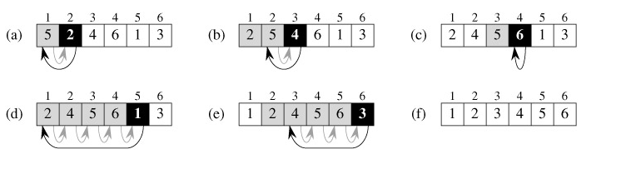
Insertion sort
Key→ 2
Key→ 4
Key → 6
Key → 1
Key → 3
Sorted Array

Slide 21
Pseudocode for insertion sort.
INSERTION-SORT(A)
1 for j = 2 to A.length
2 key = A[j]
3 // Insert A[j] into the sorted sequence A[1..j-1]
4 i = j - 1
5 While i > 0 and A[i] > key
6 A[i+1] = A[i]
7 i = i-1
8 A[i+1] = key

Slide 22
Insertion sort - Example
sorted array
(a)-(e) The iterations of the for loop → lines 1-8.
In each iteration, the black rectangle holds the key taken from A[j],
Key is compared with the values in shaded rectangles to its left → line 5.
Shaded arrows show array values moved one position to the right → line 6,
Black arrows indicate where the key is moved to → line 8.

Slide 23
Exact analysis of Insertion sort
Time taken for the algorithm will depend on the input size (number of elements of the array)
Running Time (Time complexity):
This is the number of primitive operations or steps executed through an algorithm given a particular input.

Slide 24
Running Time : T(n)
 | INSERTION-SORT(A) | Cost | Times
1 | for j = 2 to A.length | c₁ | n
2 | key = A[j] | c₂ | n-1
3 | // Insert A[j] into the sorted // sequence A[1..j-1] | 0 | n-1
4 | i = j – 1 | c₄ | n-1
5 | While i > 0 and A[i] > key | c₅ | ∑ ^{n} _{j=2} t_{j}
6 | A[i+1] = A[i] | c₆ | ∑ ^{n} _{j=2} ( t_{j} - 1)
7 | i = i-1 | c₇ | ∑ ^{n} _{j=2} ( t_{j} - 1)
8 | A[i+1] = key | c₈ | n-1
i^{th} line takes time c_{i} where c_{i} is a constant.
For each j=2,3,…,n , t_{j} be the number of times the while loop is executed for that value of j

Slide 25
Running Time(contd.)
T(n) = c₁ n + c₂ (n-1) + c₄ (n-1) + c₅ ∑ ^{n}_{j=2} t_{j}
+ c₆ ∑ ^{n} _{j=2} ( t_{j} - 1) + c₇ ∑ ^{n} _{j=2} ( t_{j} - 1) ₊ c₈(n-1)
Best Case (Array is in sorted order)
- T(n)→ an+b
Worst Case (Array is in reverse sorted order)
- T(n) → cn² + dn + e

Slide 26
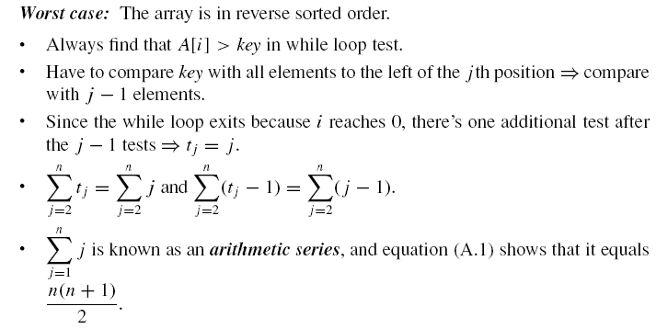
Worst Case T(n) →cn² + dn + e

Slide 27
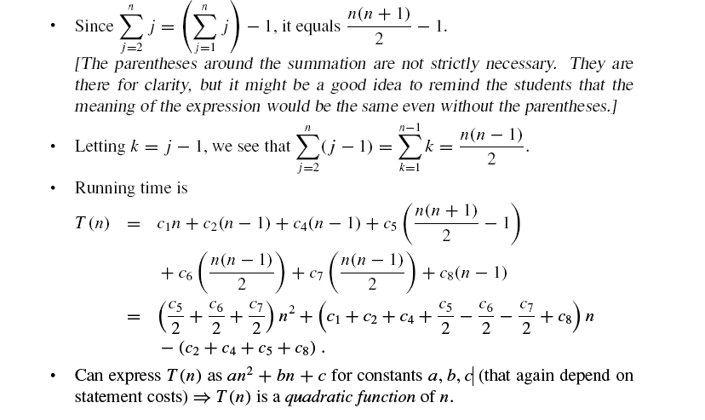
Worst Case T(n) →cn² + dn + e

Slide 28
Asymptotic Notations
RAM Model has some problems.
Exact analysis is very complicated.
Therefore we move to asymptotic notation
Here we focus on determining the biggest term in the complexity function.
Sufficiently large size of n.

Slide 29
Asymptotic Notations(Contd.)
There are three notations.
O - Notation
Θ - Notation
Ω - Notation

Slide 30
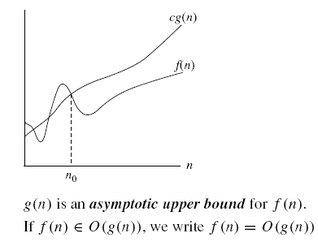
Big O - Notation
Introduced by Paul Bechman in 1892.
We use Big O-notation to give an upper bound on a function.
Definition:
O(g(n)) = { f(n) : there exist positive constants c and n_{o} such that
0 ≤ f(n) ≤ cg(n) for all n ≥ n_{o}}.
Eg: What is the big O value of f(n)=2n + 6 ?
c = 4
n_{o} = 3
g(n)=n therefore
f(n) = O(n)

Slide 31
Back to the example
Alternative calculation:
 | cost | times
sum = 0 | c₁ | 1
for i = 1 to n | c₂ | n+1
sum = sum + A[i] | c₃ | n
T(n) = c₁ + c₂ (n+1) + c₃ n
= (c₁ + c₂) + (c₂ + c₃) n
= c₄ + c₅ n
→ O (n)
Proof: c₄ + c₅ n ≤ c n → TRUE for n≥1 and c ≥ c₄ + c₅

Slide 32
Big O – Notation(Contd.)
Assignment (s = 1)
Addition (s+1)
Multiplication (s*2)
Comparison (S<10)
O(1)

Slide 33
Question
Find the Big O value for following fragment of code.
for i = 1 to n
for j = 1 to i
Print j
O(n²)

Slide 34
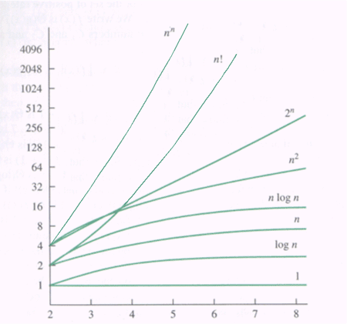
Graphs of functions

Slide 35
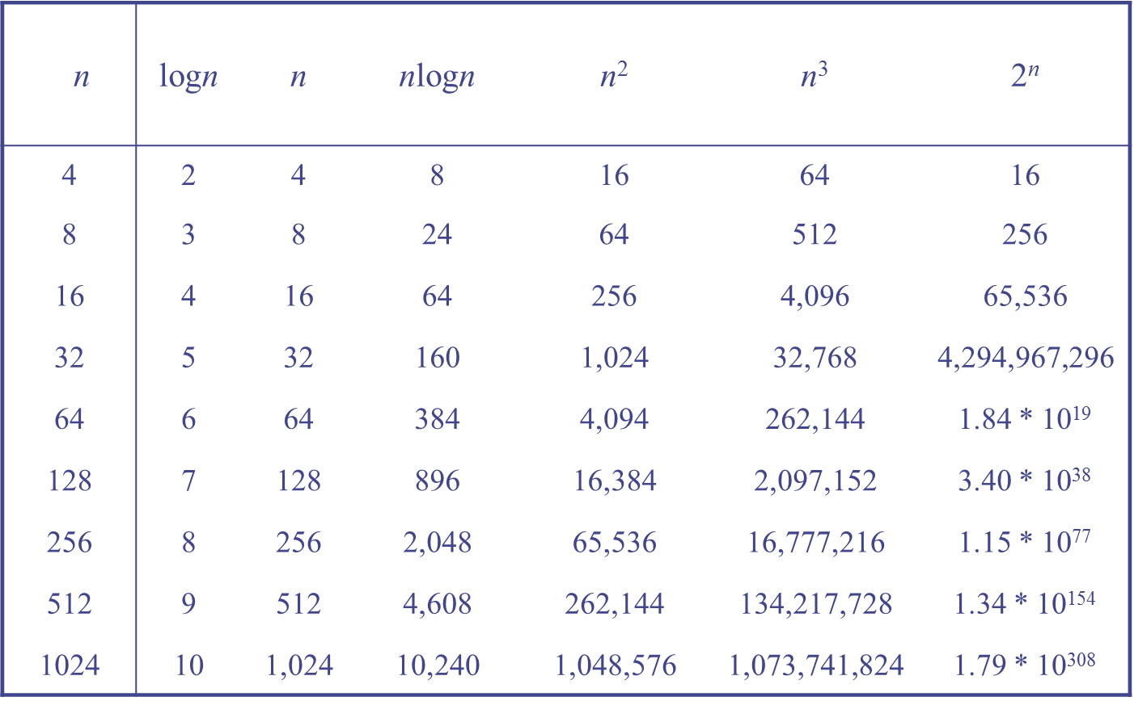

Slide 36
Big O – Notation(Contd.)
Find the Big O value for the following functions.
(i) T(n)= 3 +5n + 3n²
(ii) f(n)= 2^{n} + n² +8n +7
(iii) T(n)= n + logn +6
Answers:
(i) O(n²)
(ii) O(2^{n})
(iii) O(n)

Slide 37
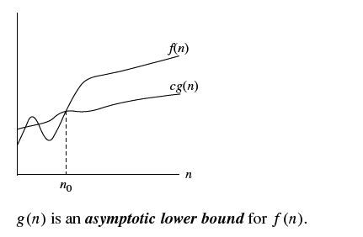
Ω - Notation
Provides the lower bound of the function.
Definition:
Ω(g(n)) = { f(n) : there exist positive constants c and n₀ such that 0 ≤ cg(n) ≤ f(n) for all n ≥ n_{o}}

Slide 38
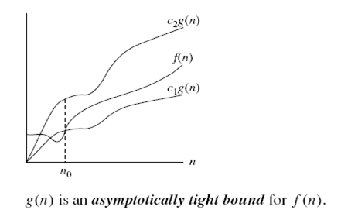
Θ - Notation
This is used when the function f can be bounded both from above and below by the same function g.
Definition:
Θ(g(n)) ={ f(n): there exist positive constant c₁, c₂, and n₀ such that 0≤ c₁ g(n) ≤ f(n) ≤ c₂g(n) for all n ≥ n₀ }

Slide 39
Summary
What is an algorithm?
Properties of an algorithm.
Design methods.
Pseudocode.
Analysis(Operation count & Step count, RAM model).
Insertion Sort.
Asymptotic Notation

Slide 40
References
T.H. Cormen, C.E. Leiserson, R.L. Rivest, Clifford Stein Introduction to Algorithms,3rd Edition, MIT Press, 2009.

